Slide 1





Slide 2

The project is aimed at providing ease access for books at library.
In the existing system ,the information of books available in the library is only maintained at the librarian and it is not available to the users. This makes them difficult to search for their desired book. It also does not have methods to check for the availability of books present in the library.
The proposed methodology includes an user interface which helps the student to search a book by name, search book by author, search book by branch wise and year wise, search journals, finally check status. Search book by name includes information like book name, check book availability, book location, edition available. Search book by author includes all the options of search book by name and also includes extra feature like books written by the same author, search by subject includes related books, search journals and project reports includes year wise projects and journals, check card status tells the remaining books available in his account.

Slide 3

Software requirements
Front end : php,html ,css ,java script.
Back end : mysql.
Server :Apache server.
Hardware requirements
Minimum 350MB Hard Disk space for installation
Recommended minimum CPU - Pentium 4, 3.2GHz

Slide 4

MODULES :
Search by book name.
Search by author name.
Search by isbn number.
Search by publisher.
Search journals,e-books,cd’s.
Check card status.
Admin login

Slide 5

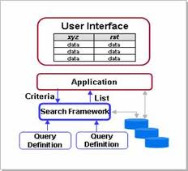

Slide 6



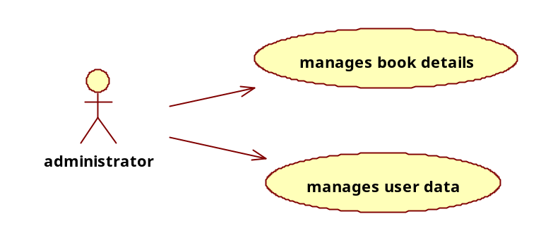
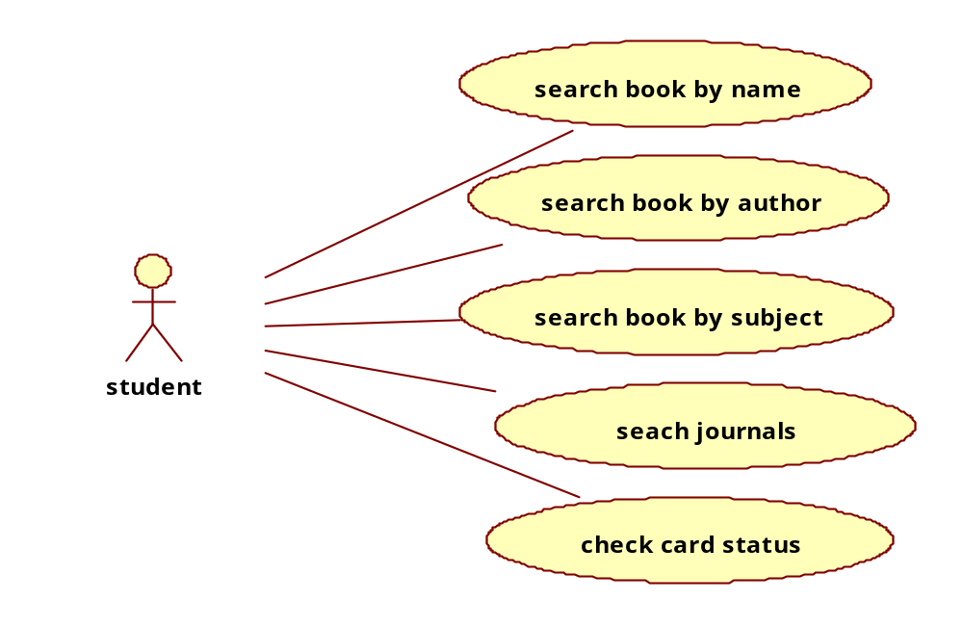

Slide 7

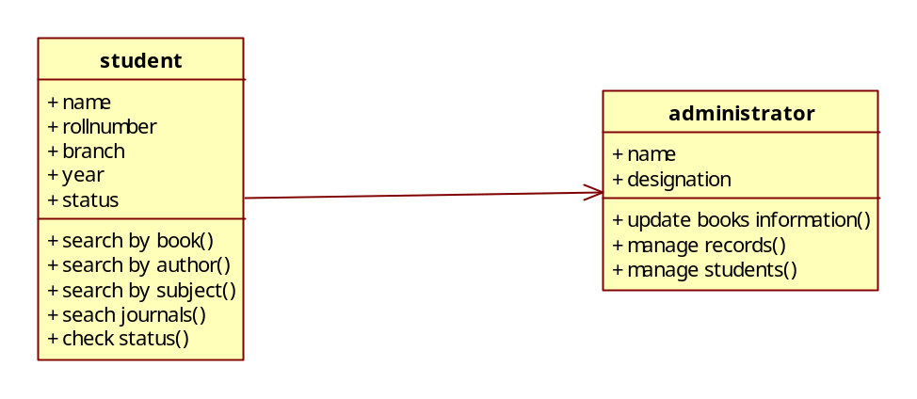

Slide 8

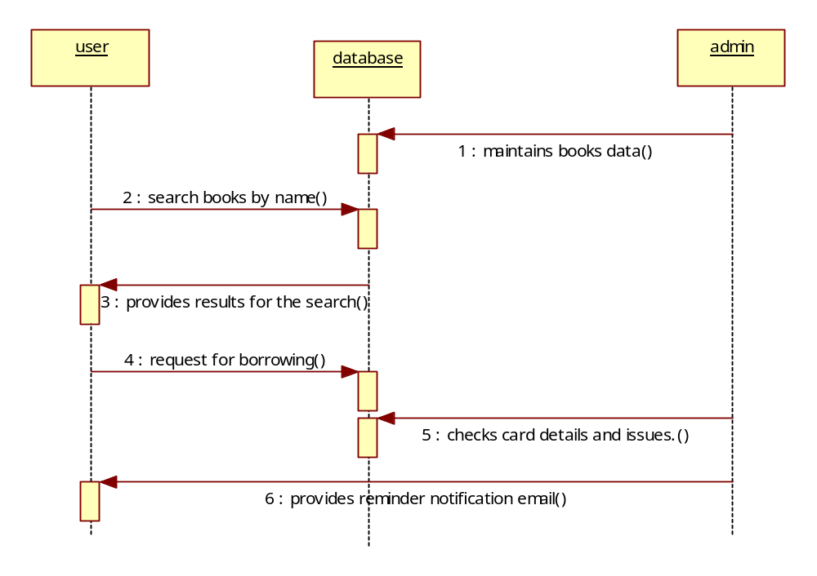

Slide 9

Features of PHP:
  Speed
  Full database Support
  Open source and free to download and use.
  Cross platform
  Easy for newcomer and advance features

Slide 10
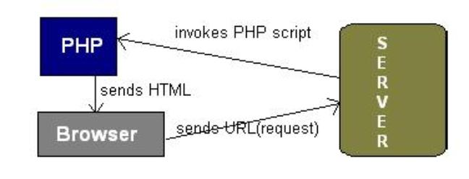
Working of PHP:
  URL is typed in the browser.
  The browser sends a request to the web server.
  The web server then calls the PHP script on that page.
  The PHP module executes the script, which then sends out the result in the form of HTML back to the browser, which can be seen on the screen.

Slide 11
MySQL:
  MySQL is the most popular open source database server.
  A database defines a structure for storing information.
  With MySQL, we can query a database for specific information and have a recordset returned.
  MySQL is ideal for both small and large applications
  MySQL supports standard SQL
  MySQL compiles on a number of platforms
  MySQL is free to download and use
  PHP combined with MySQL are cross-platform (means that you can develop in Windows and serve on a Unix platform)

Slide 12

  In PHP, connection is established using
the mysql_connect() function.
  Syntax:
mysql_connect(servername,username,password);
ex <?php
$con = mysql_connect("localhost",“root",“ ");
if (!$con)
{
die('Could not connect: ' . mysql_error());
}
// some code
?>

Slide 13
Closing a connection:
  The connection is closed as soon as the script ends. To close the connection use the mysql_close() function.
ex. <?php
$con = mysql_connect("localhost",“root","");
if (!$con)
{
die('Could not connect: ' . mysql_error());
}
// some code
mysql_close($con);
?>

Slide 14
WAMP Server:
  W :- Windows XP/Vista
  A :- Apache version 2.2.22
  M :- MySQL version 5.0.45
  P :- PHP version 5.2.5

Slide 15
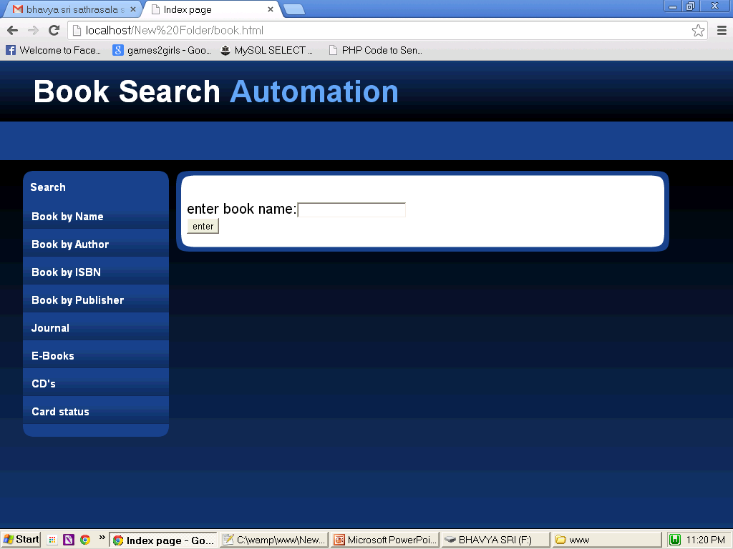
Main page

Slide 16
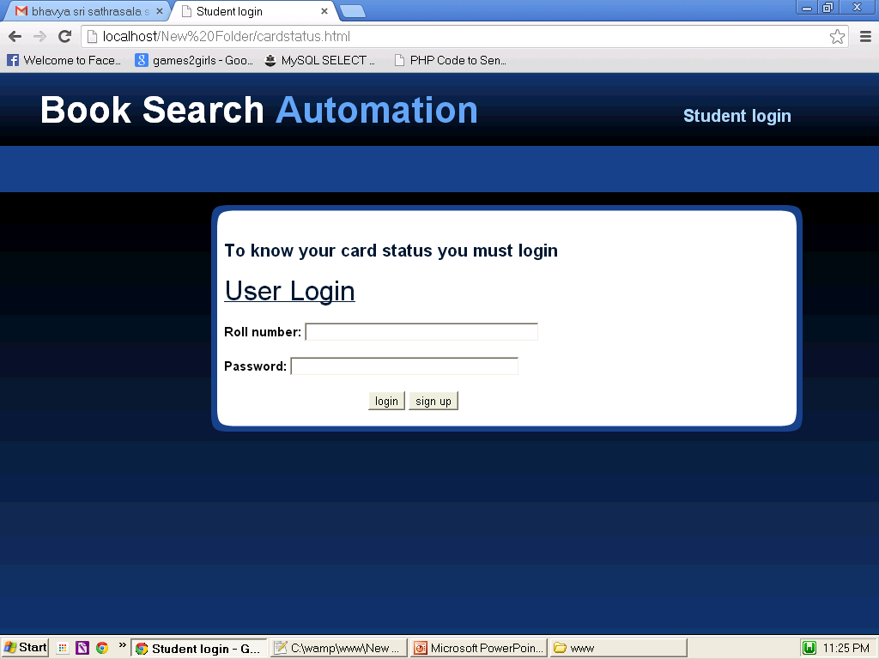
When card status is clicked

Slide 17
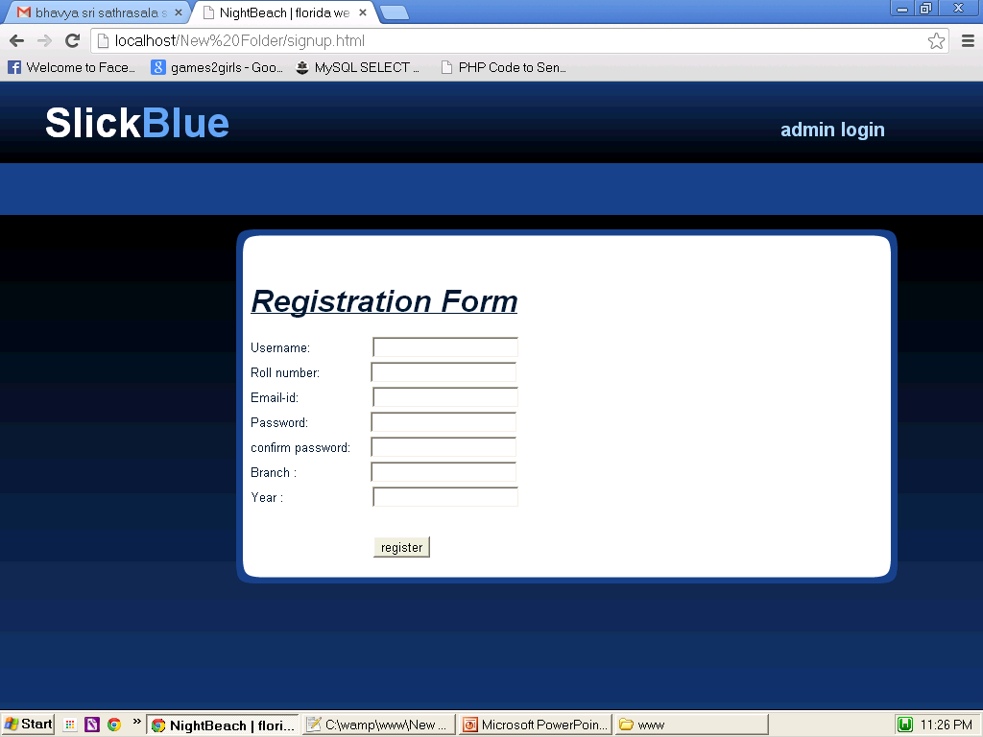
When sign up is clicked

Slide 18
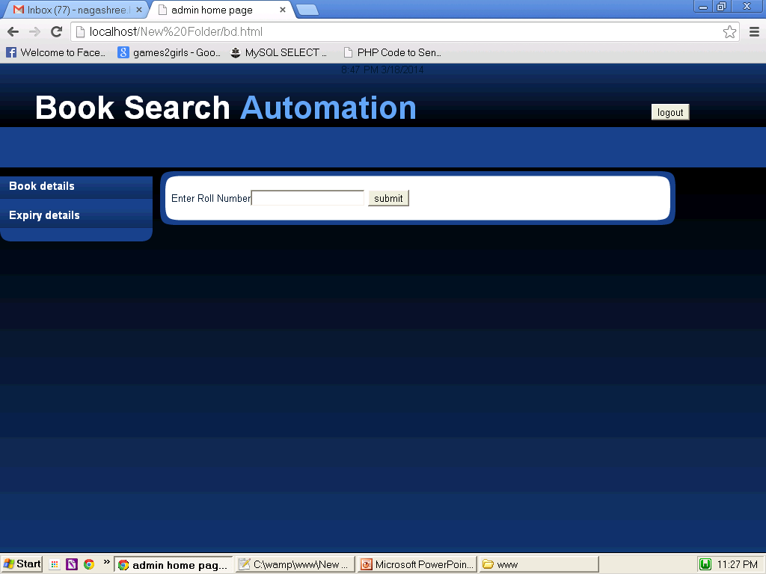
On successful login

Slide 19
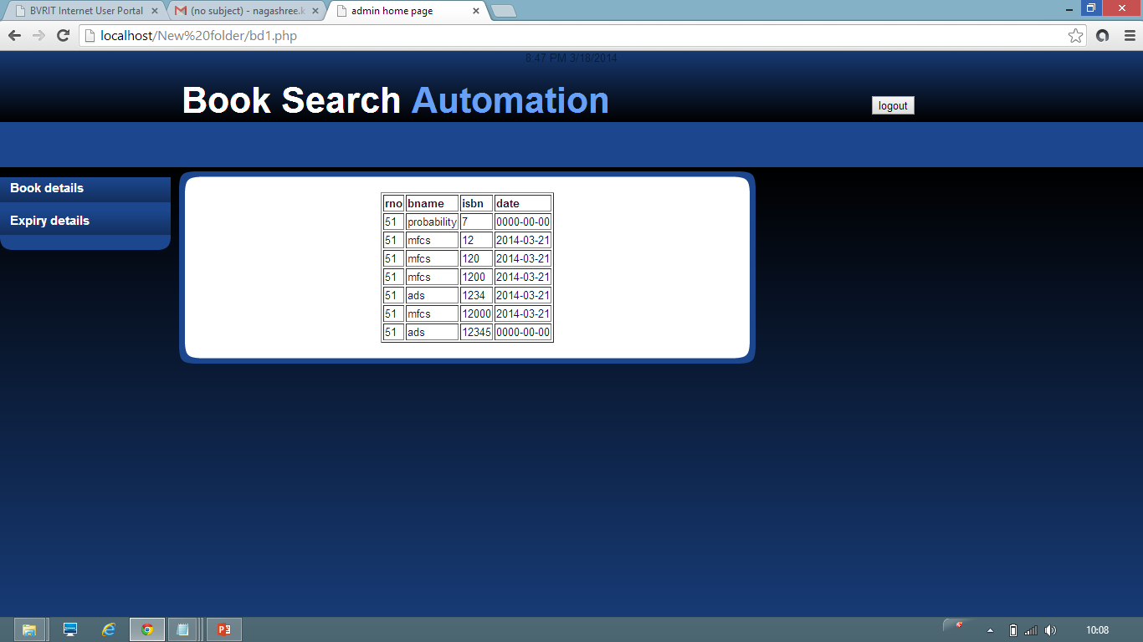
Book details

Slide 20
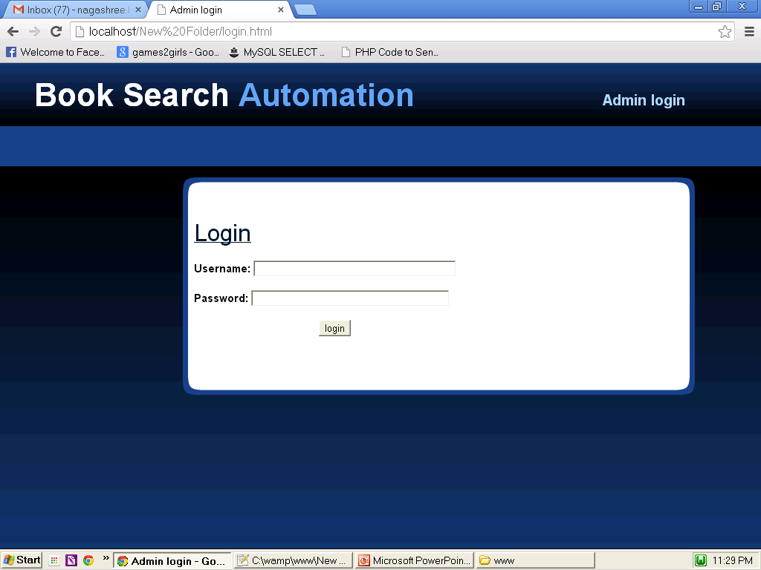
For admin to login

Slide 21
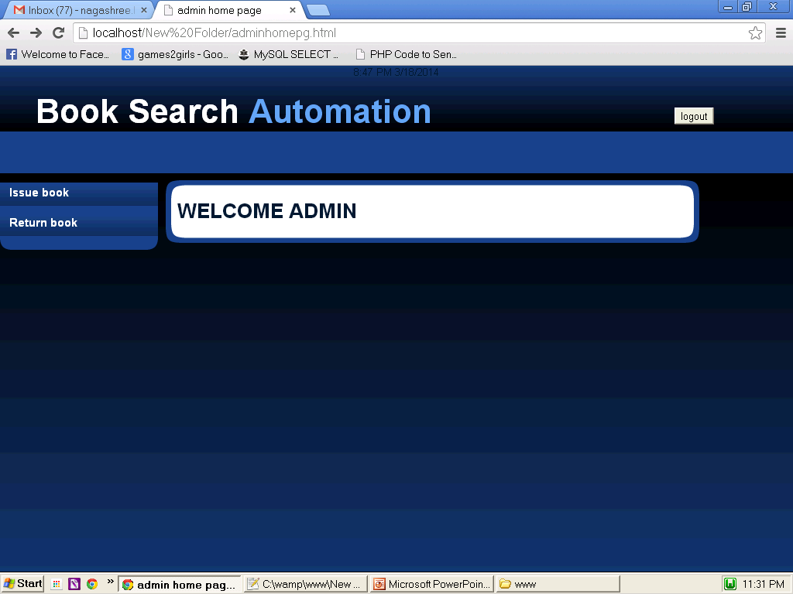
When admin login’s successfully

Slide 22
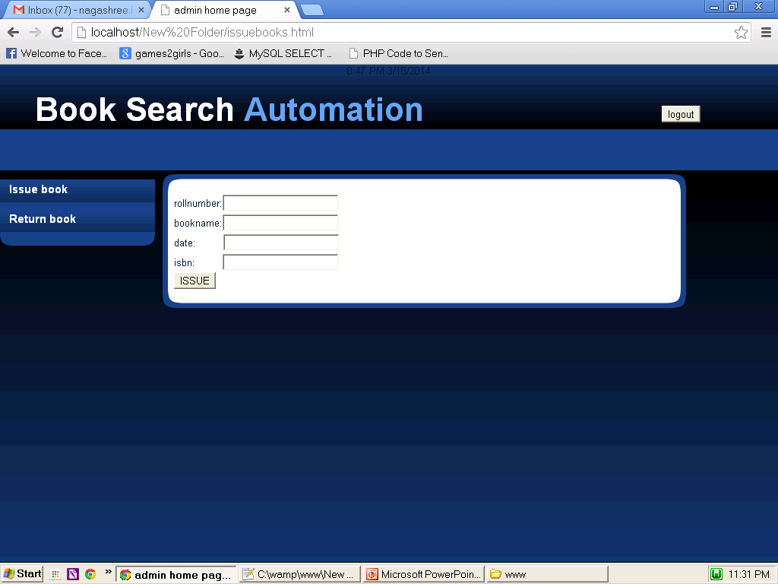
Issue book

Slide 23

Return book

Slide 24
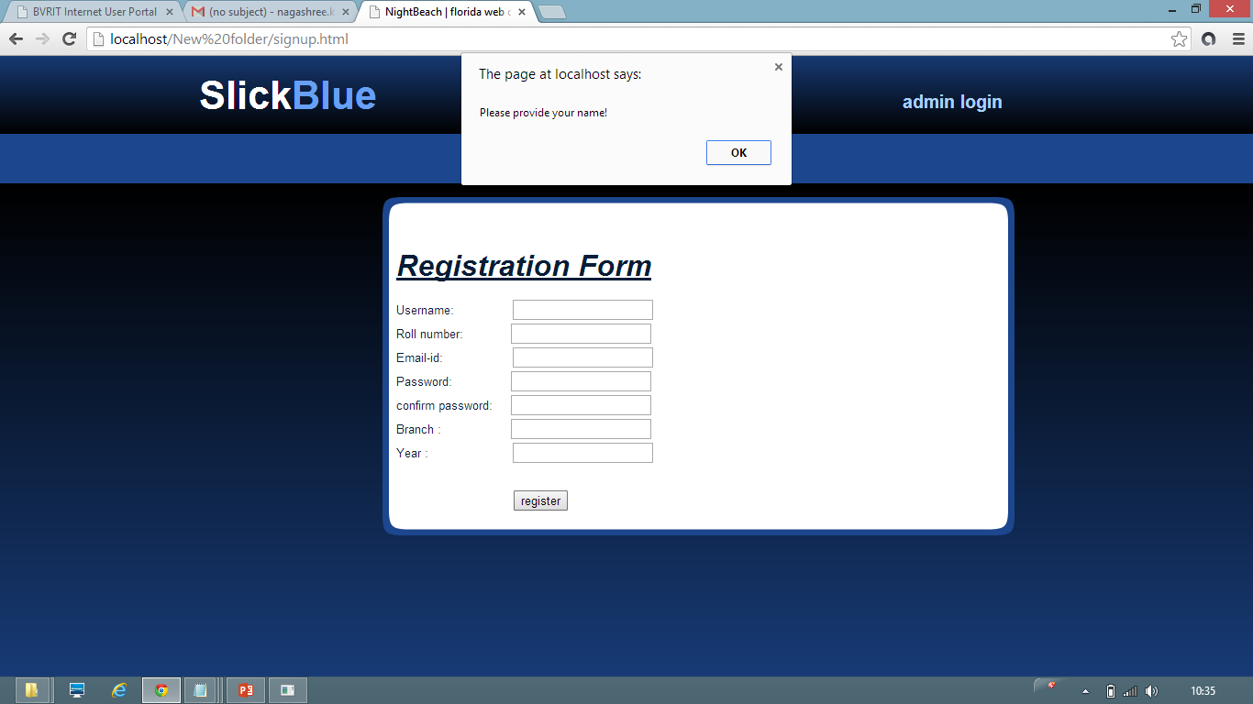
Test case-1

Slide 25
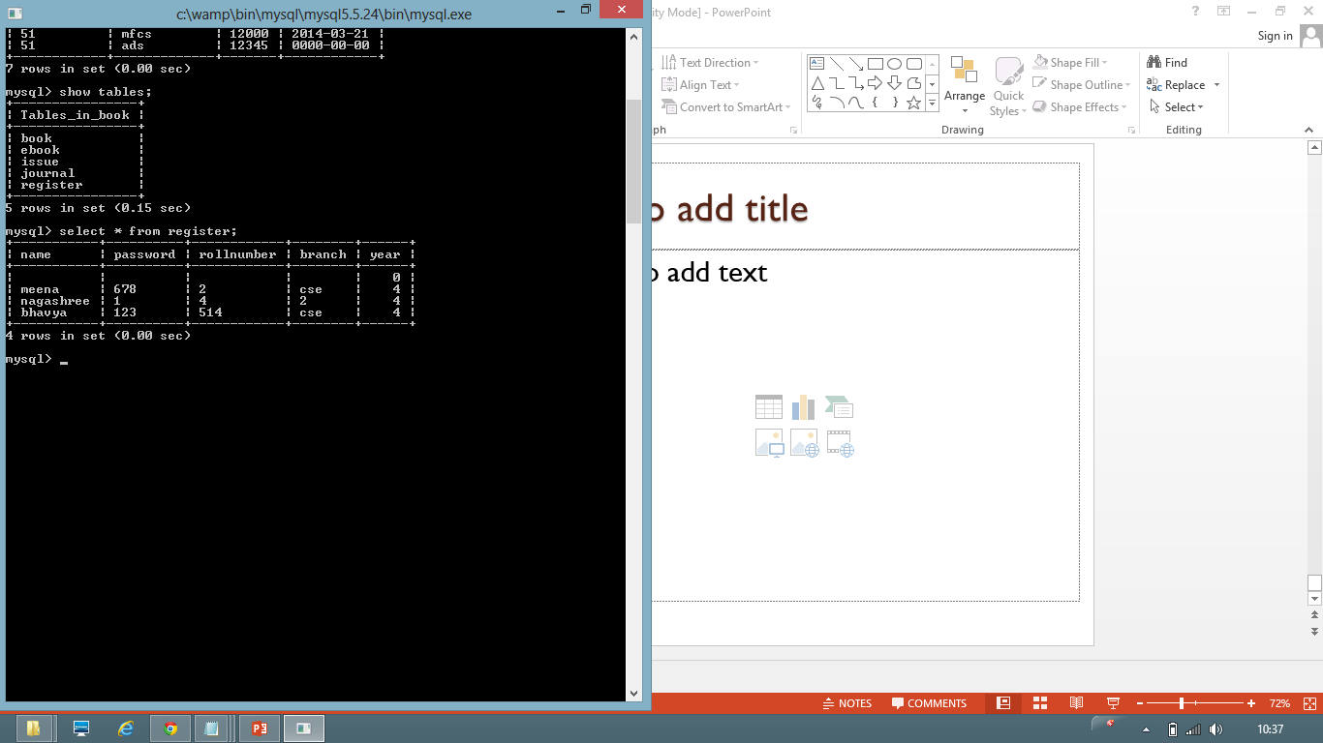
Testcase 2

Slide 26
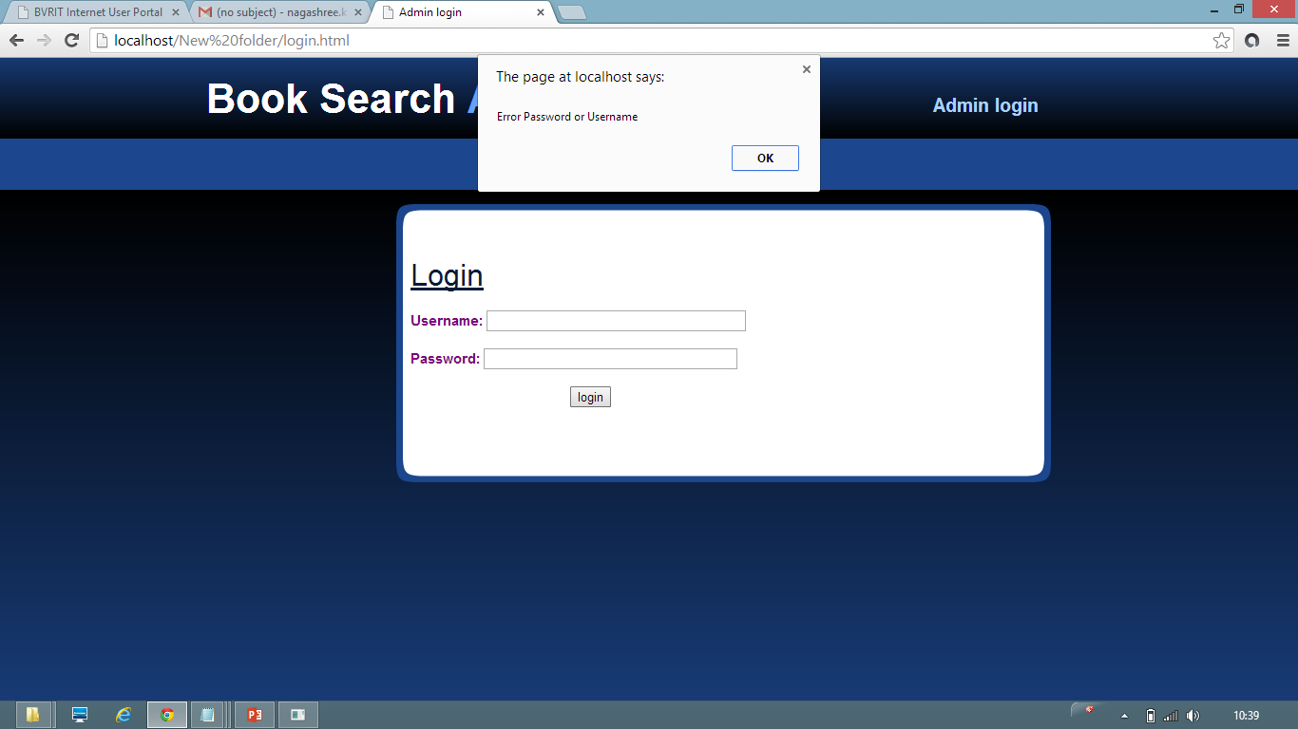
Testcase 3

Slide 27
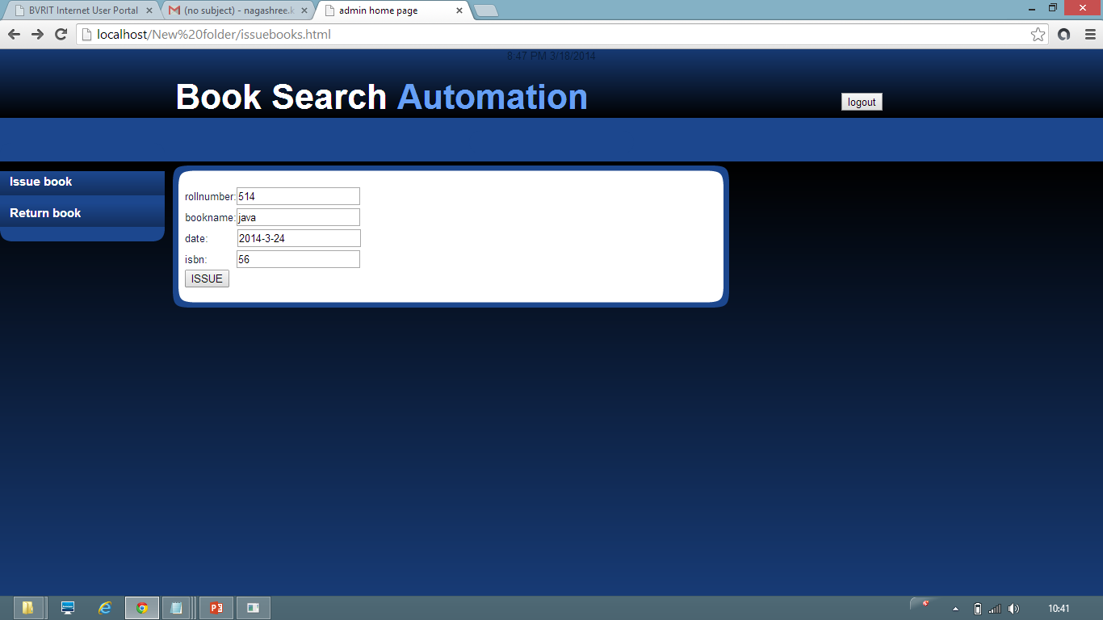
Testcase 4

Slide 28
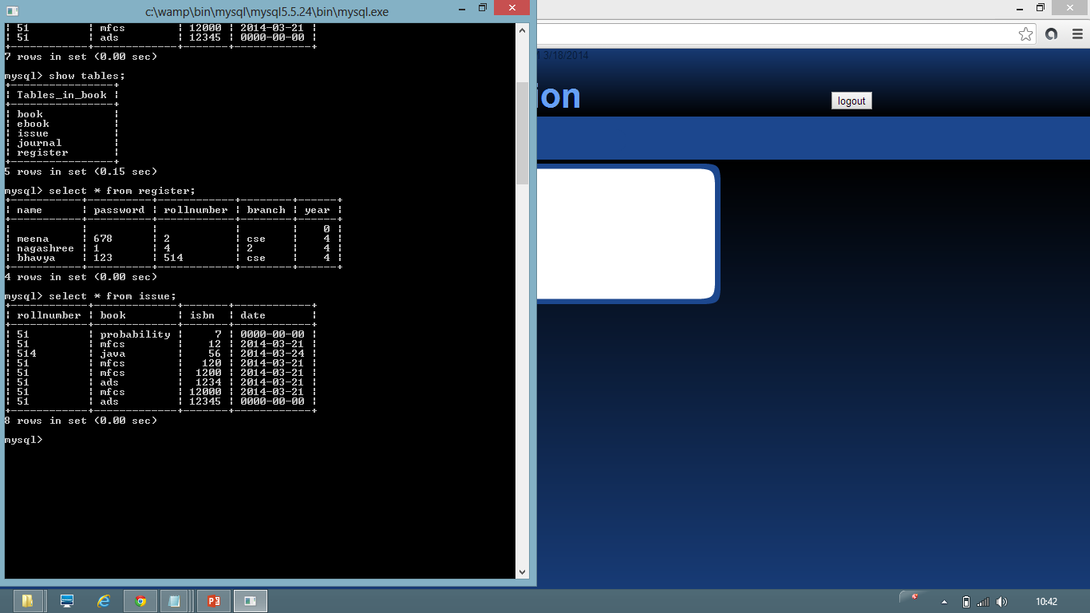
Testcase 4

Slide 29

Testcase 5

Slide 30
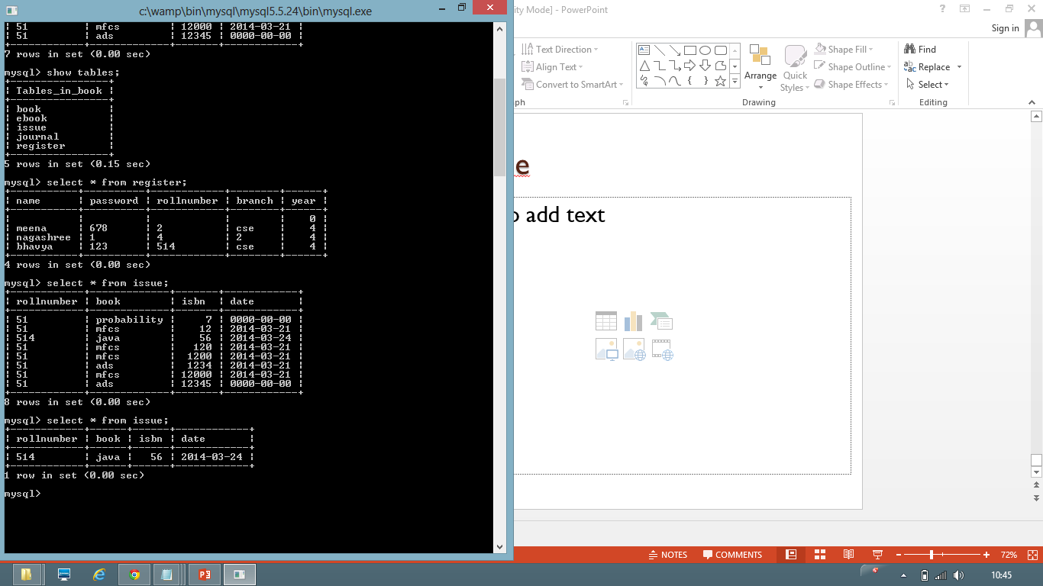
Testcase 5

Slide 31

References
http://www.w3schools.com/
http://www.tutorialspoint.com/mysql
http://www.phpmyadmin.net

Slide 32
THANK YOU

